Slide 1
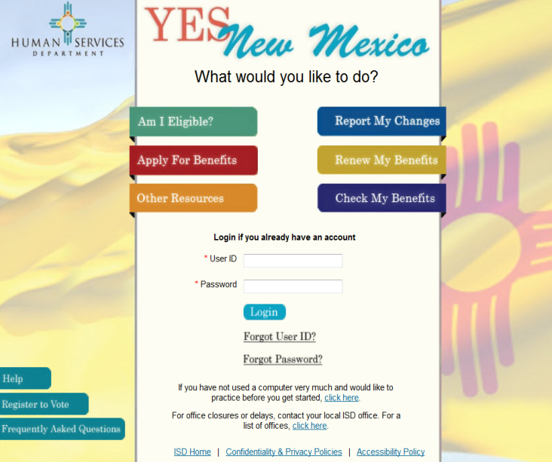
YES - New Mexico New Mexico’s Self-Service Eligibility Portal www.yes.state.nm.us
What is YES-NM? It is New Mexico’s self-service portal. Applicants may use it to apply for public assistance benefits such as Medicaid, SNAP (formerly known as food stamps), cash assistance, and LIHEAP (Low-Income Heating and Energy Assistance Program). You may also use the website to Report Changes, Renew Your Benefits, and Check Your Benefits.
What does YES-NM look like?
How do I access YES-NM? It is simple: 1) click on your Internet Explorer icon, 2) type www.yes.state.nm.us in your internet browser, 3) create an account or login into an existing account, 4) link your account and 5) select the appropriate button depending on the action you want to take.
How long does it take to apply? It depends on many factors (number of household members, income sources, benefit categories applying for and resources). On average, completing an application takes about 45 minutes.
Can I finish my application at another time? Yes. YES-NM prompts you to create a username and password so that you can start & stop and access your application at a later time to complete it.
What types of changes can I report on YES-NM? YES-NM displays a list of changes you can make including changes in income, expenses, household composition, death, births, address, and marital status.
How do a “Renew My Benefits”? This button only displays for recipients who are due for a recertification in the following month. You can renew all or your benefits at the same time. If you have different case numbers, you will need to renew each case number separately.
What information can I get using “Check My Benefits”? This section displays the status of your benefits, any upcoming or missed appointments, any outstanding verifications needed, and the status of any Change Reports , Recertification or Fair Hearing requests. It also provides information on any applications submitted including the application number, the date submitted, application details and the status of application.
Is there another way to “Check My Benefits”? Yes The Income Support Division Information Line allows New Mexicans to check details of their case. These details include the status of your case, benefit amounts, any upcoming appointments or pending documents needed for case processing. The Information line is available 24/7. Just dial 1-855-309-3766 and listen to provided options for proper assistance.
Can I scan or upload my eligibility verifications using YES-NM? Yes. If you scan or upload required verifications (i.e. proof of income), the Human Services Department will be able to process your application more quickly.
Can I still apply using a paper application? Yes. Paper applications may be dropped off at your local HSD office. You may also mail them to: Central ASPEN Scanning Area P.O. Box 830 Bernalillo, NM 87004. For Medicaid only applications, call the Medicaid Expansion Hotline at 1-855-637-6574.
Effective February 3, 2104 – New Lobby Hours: 9:00 a.m. to 4:00 p.m.

