Slide 1




Training for the SNCP Uncompensated Care (UC) Payment Application
DEDICATED TO GOVERNMENT HEALTH PROGRAMS

Slide 2
UNCOMPENSATED CARE POOL
OVERVIEW
DEDICATED TO GOVERNMENT HEALTH PROGRAMS

Slide 3
Myers and Stauffer Contact Information
  Chris Maben, Senior Accountant
    maben@mslc.com
  Reuben Merriman, Senior Accountant
    rmerriman@mslc.com
  Julia Hill, Senior Manager
    juliah@mslc.com
  Telephone: (505)243-3486
DEDICATED TO GOVERNMENT HEALTH PROGRAMS

Slide 4
UC PAYMENT POOL OVERVIEW
Uncompensated care payments will be paid for five demonstration years (DY)
  Calendar Years 2014 – 2018
  Each year a total of $68,889,323 will be allocated to qualifying providers
DEDICATED TO GOVERNMENT HEALTH PROGRAMS

Slide 5

UC PAYMENT POOL OVERVIEW
Eligible Providers
  Only Sole Community Providers (SCP) and Teaching hospitals are eligible for UC payments.
  Eligible hospitals are placed in one of 5 groups based on beds:
    Smallest Hospitals: 30 Beds or Fewer
    Small Hospitals: 31 - 100 Beds
    Medium Hospitals: 101 – 200 Beds
    Large Hospitals: 201 – 300 Beds
    Largest Hospitals: 301 or More Beds
DEDICATED TO GOVERNMENT HEALTH PROGRAMS
Notes:
UC payment was created to replace the supplemental payments (SCP and UPL).

Slide 6
UC PAYMENT POOL OVERVIEW
The UC payments are allocated primarily to the smallest hospitals in the state.
  60% of total funds go to hospitals with 30 beds or less ($41,333,594)
  30% of total funds go to hospitals with 31 – 100 beds ($20,666,797)
  10% of total funds go to hospitals with 101 – 200 beds ($6,888,932)
DEDICATED TO GOVERNMENT HEALTH PROGRAMS

Slide 7

QUESTIONS
DEDICATED TO GOVERNMENT HEALTH PROGRAMS

Slide 8
UNCOMPENSATED CARE PAYMENTS
APPLICATION
DEDICATED TO GOVERNMENT HEALTH PROGRAMS

Slide 9
UC PAYMENT APPLICATION
The UC Payment Application was created using the DSH examination tool (section A – K, and “UCC Summary” tab).
The “Payment Adjustments” tab was designed to account for estimates in payments and/or Medicaid utilization.
  The UCC calculated using the application is based on historical data (2014) and will not always reflect reimbursement methods in the UC payment year (2016).
DEDICATED TO GOVERNMENT HEALTH PROGRAMS
Notes:
- An example is in 2014 the Affordable Care Act and Centennial Care expanded the number of Medicaid recipients in the state. 2014 was the first DY year, and applications were processed using 2012 data which did not account for the rise in DRG rates, nor the new Medicaid participants that would have previously been captured as uninsured.

Slide 10
UC PAYMENT APPLICATION
Section A
  Line 1 will report the Calendar Year the application is for:
    This year will be 1/1/16 through 12/31/16
  Line 2 will report the UC Base/Reconciliation year
    This year will be 1/1/14 through 12/31/14
  Line 3 will report the Facility Name.
  Line 4 will report the cost report period used to complete section G.
    The Cost Report used will be the cost report that covers the most claims in the base year. (Calendar Year 2014)
  Lines 5 through 8 will report facility Medicaid and Medicare Numbers.
DEDICATED TO GOVERNMENT HEALTH PROGRAMS

Slide 11
UC PAYMENT APPLICATION
Section C
  Supplemental payments received by the facility in the calendar base year will be reported here.
    The base year for the application due December 31 will be 1/1/14 through 12/31/14.
    Supplemental payments are GME, IME and DSH.
      Providers will need to combine data from two supplemental payment periods as these are paid on the State Year (6/30).
DEDICATED TO GOVERNMENT HEALTH PROGRAMS
Notes:
For 2016 application we will also include the lump sum payments paid by two MCO’s for increases to patient payments.

Slide 12
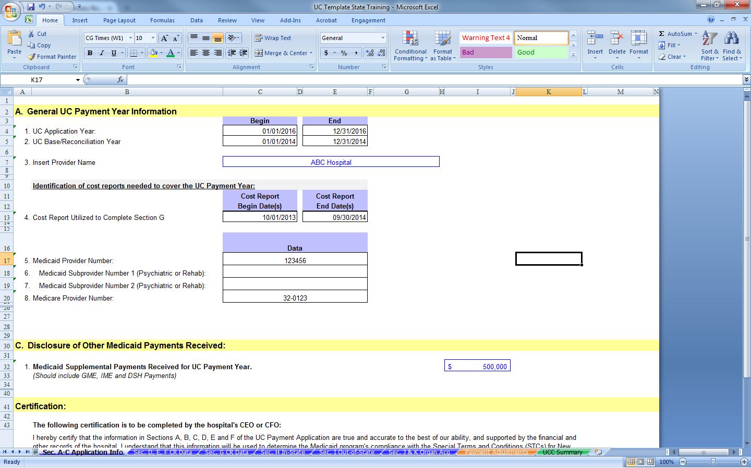
UC PAYMENT APPLICATION
Years impacted by
the application.
Application year and
Base (Recon) year
DEDICATED TO GOVERNMENT HEALTH PROGRAMS
12

Slide 13
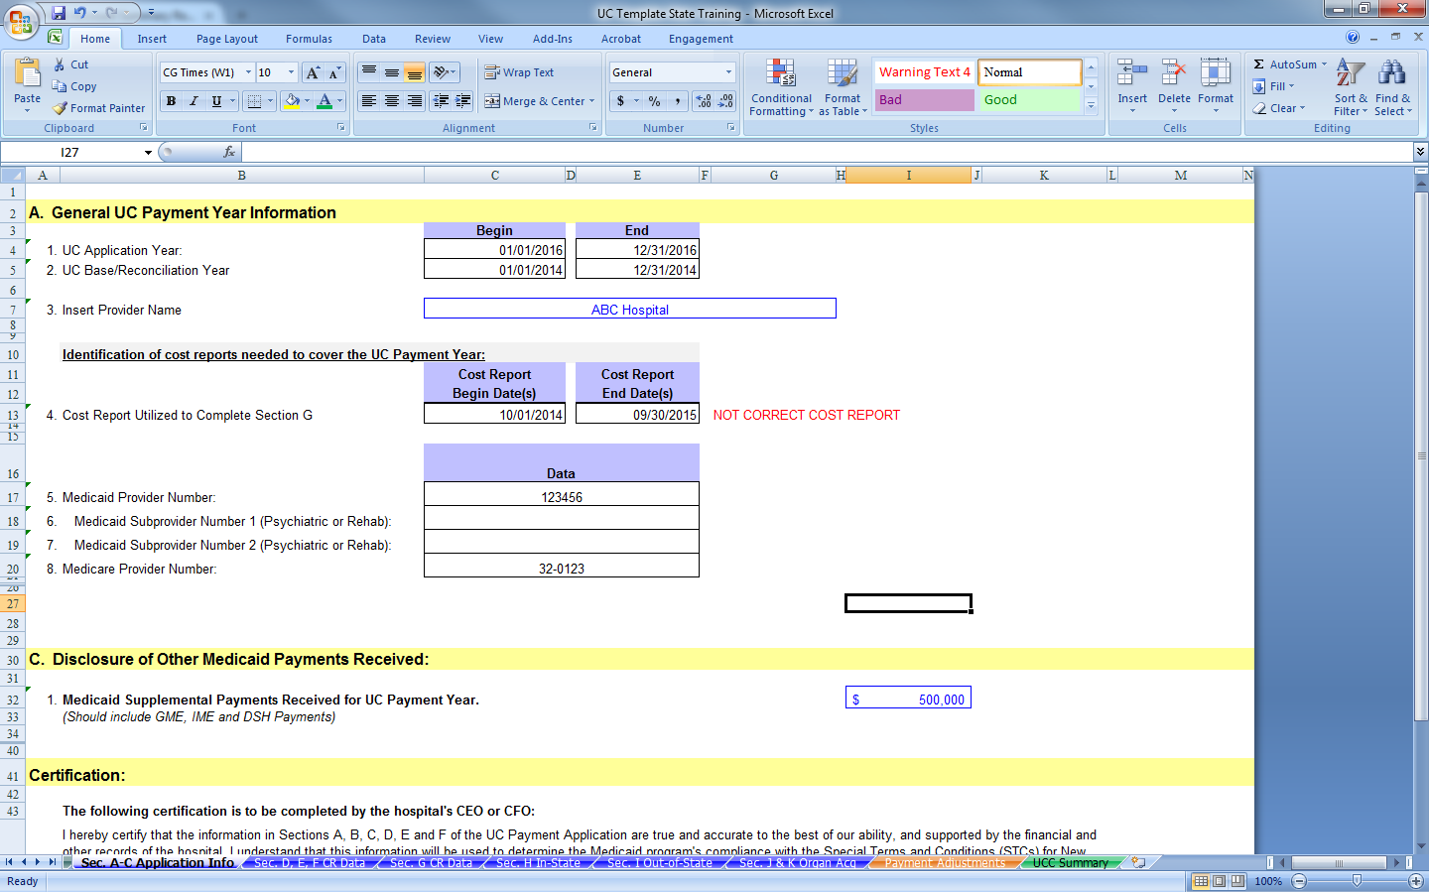
UC PAYMENT APPLICATION
Will appear if the cost
report does not cover 6
months of the base year.
DEDICATED TO GOVERNMENT HEALTH PROGRAMS
13

Slide 14
UC PAYMENT APPLICATION
Section D
  Provider identification information
  Data will flow from section A with the exception of Out-of-State Medicaid numbers.
DEDICATED TO GOVERNMENT HEALTH PROGRAMS

Slide 15
UC PAYMENT APPLICATION
Section E – Disclosure of Medicaid / Uninsured Payments Received
  Lines 1 – 7 are used to report 1011 payments.
  Line 8 is used to report out-of-state DSH payments.
  Line 9 is used to report uninsured self-payments.
    Should agree to section H (Excel Cells AN137 and AP137)
  Line 10 is used to report all other self payments. (co-pays/deductibles)
DEDICATED TO GOVERNMENT HEALTH PROGRAMS

Slide 16
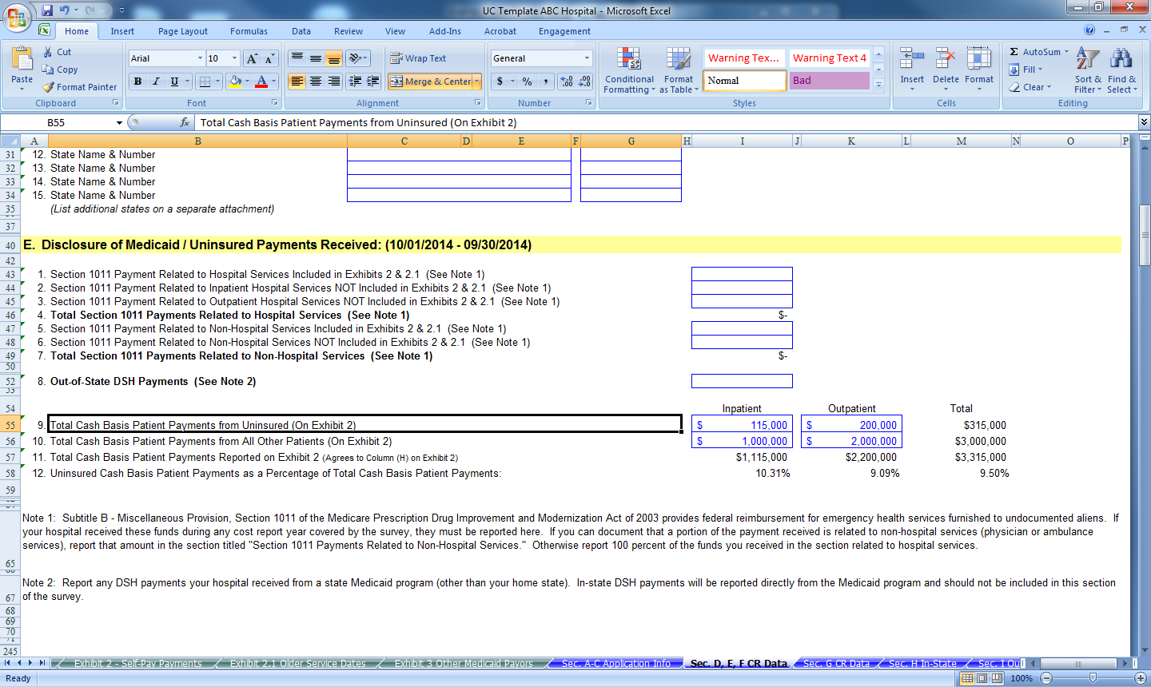
UC PAYMENT APPLICATION
Should agree to schedule H
DEDICATED TO GOVERNMENT HEALTH PROGRAMS

Slide 17
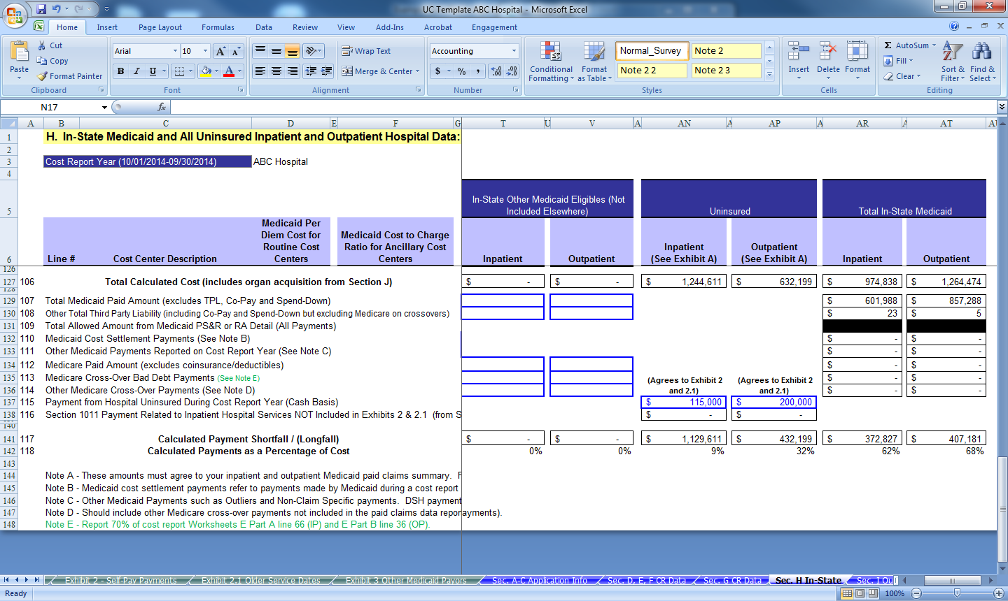
UC PAYMENT APPLICATION
Should agree to schedule E
DEDICATED TO GOVERNMENT HEALTH PROGRAMS

Slide 18
UC PAYMENT APPLICATION
Section G – Cost Report
  This section will be populated using the cost report that contains the most 2014 calendar year claims.
    Providers with year ends 1/31 through 5/31 will use their 2015 cost report.
    Providers with year ends 7/31 through 12/31 will use their 2014 cost report.
    Providers with 6/30 year ends can use either their 2014 cost reports or the 2015 cost report.
DEDICATED TO GOVERNMENT HEALTH PROGRAMS
Notes:
6/30 providers choosing to use their 2014 cost report for the 2016 application will have to use their 2015 cost report to complete the 2017 application. If they 2015 cost report is utilized to complete the 2016 application the 2016 cost report must be used to complete the 2017 application.

Slide 19
UC PAYMENT APPLICATION
Section G is split between Routine cost centers and Ancillary cost centers.
  Routine cost center data is used to calculate per diems. (cost center costs/cost center days)
  Ancillary cost center data is used to calculate cost to charge ratios. (cost center costs/cost center charges)
  These ratios are half of the equation in determining
  patient costs on schedules H and I.
DEDICATED TO GOVERNMENT HEALTH PROGRAMS

Slide 20
UC PAYMENT APPLICATION
Routine Per Diems and Cost to Charge Ratios are calculated as follows:
Numerator (same for both)
  Begin with total allocated costs to cost center (from cost report schedule B Part I Column 26)
  Add interns and residents costs (from cost report schedule B Part I column 25)
  Add back RCE and Therapy costs (from cost report schedule C Part I columns 2 and 4)
  Remove Swing-Bed Carve Out (from cost report schedule D-1 Part I Line 26)
    Only A&P cost center
DEDICATED TO GOVERNMENT HEALTH PROGRAMS

Slide 21
UC PAYMENT APPLICATION
Denominator
  Routine - Days for cost center (from cost report schedule D-1 part I Line 2 for Adults and Peds; schedule D-1 part II lines 42-47 for other routine cost centers.
  Ancillary - Inpatient and Outpatient cost center charges (from cost report schedule C Part I columns 6 and 7).
DEDICATED TO GOVERNMENT HEALTH PROGRAMS

Slide 22
UC PAYMENT APPLICATION
Observation – This cost center utilizes the A&P per diem to calculate a cost to charge ratio.
  Numerator - A&P per diem x observation days (reported on cost report schedule S-3 part I Line 28 Col. 8).
  Denominator – Observation inpatient and outpatient charges (from cost report schedule C part I columns 6 and 7).
DEDICATED TO GOVERNMENT HEALTH PROGRAMS

Slide 23
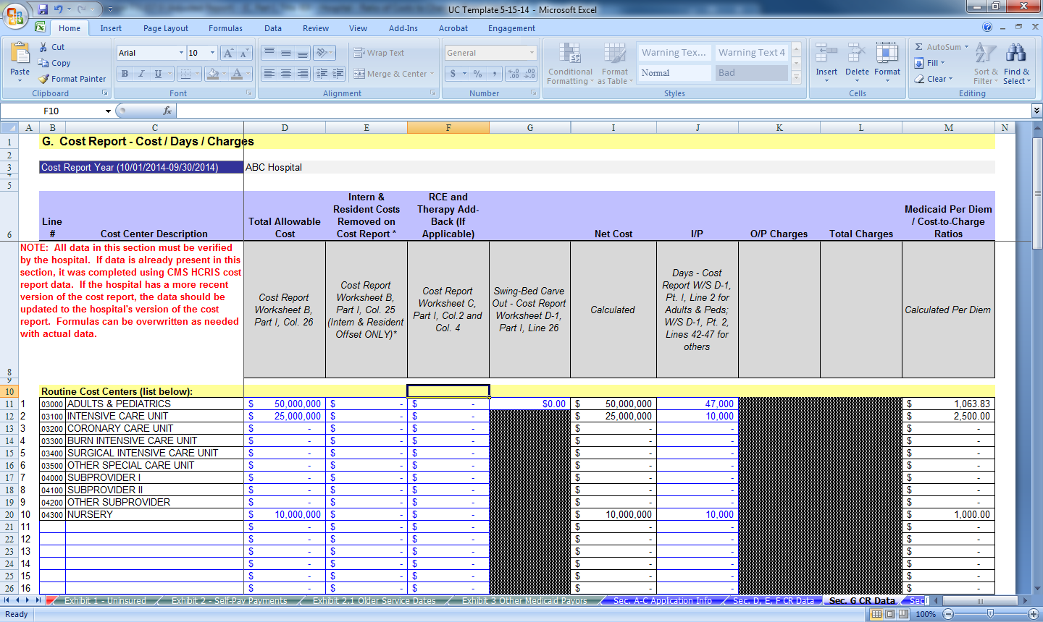
UC PAYMENT APPLICATION
Routine per diem calculation
DEDICATED TO GOVERNMENT HEALTH PROGRAMS

Slide 24
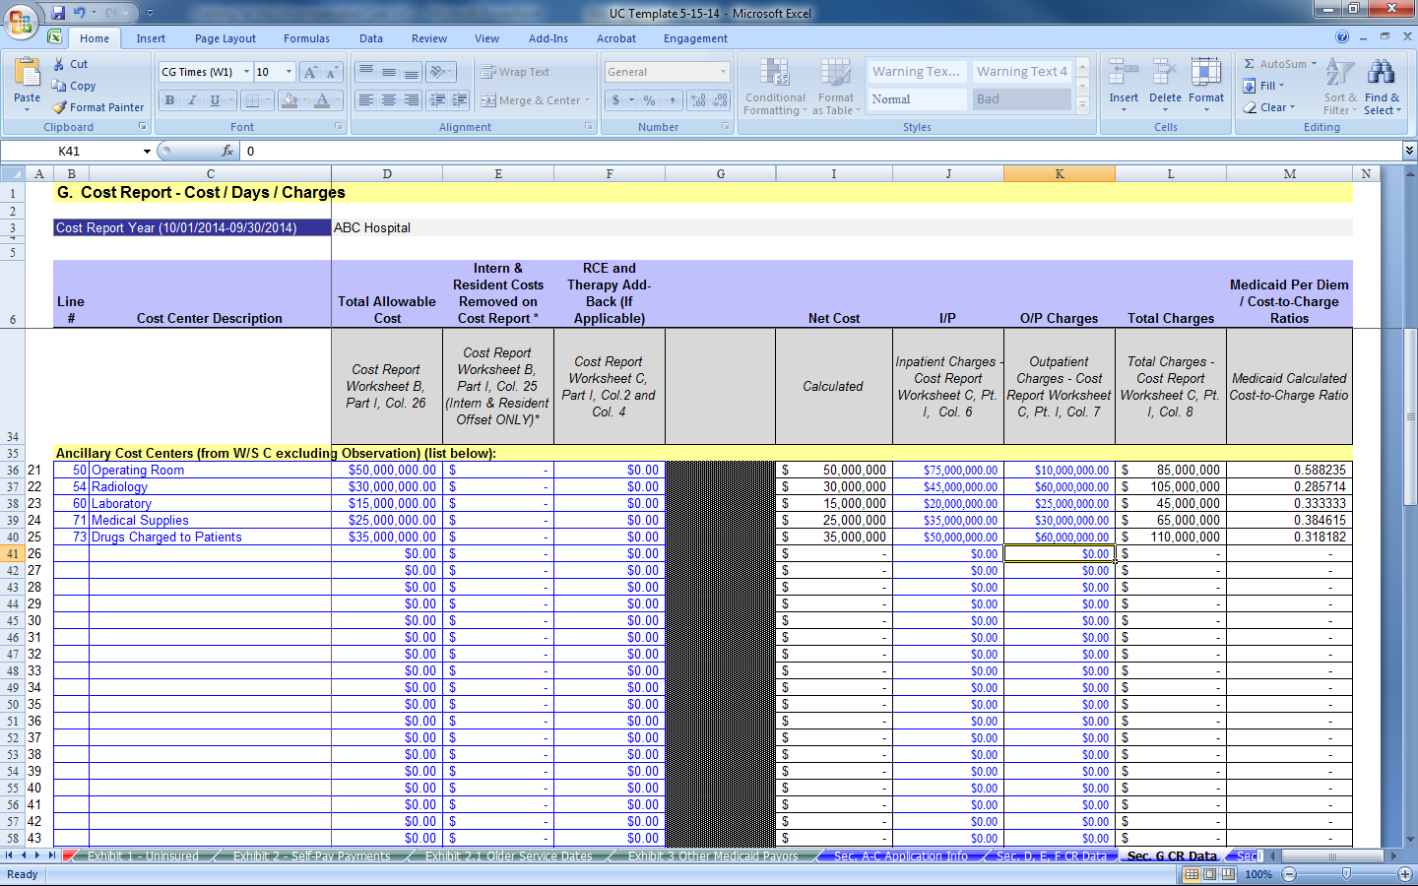
UC PAYMENT APPLICATION
Ancillary cost-to-charge ratio calculation
DEDICATED TO GOVERNMENT HEALTH PROGRAMS

Slide 25
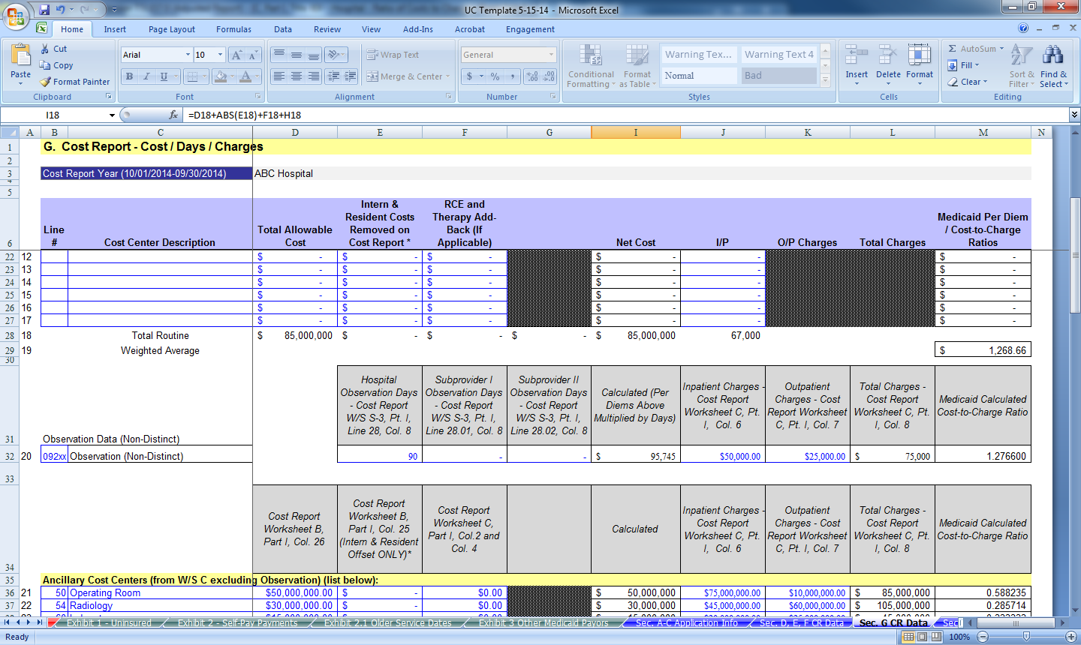
UC PAYMENT APPLICATION
Observation cost-to-charge ratio calculation
DEDICATED TO GOVERNMENT HEALTH PROGRAMS

Slide 26
UC PAYMENT APPLICATION
Sections H and I are utilized to report in-state, out-of-state and uninsured claims data.
  Section H is used to report In-State FFS, MCO, FFS Cross-Over, Other Medicaid Eligible and Uninsured claims data.
  Section I is used to report Out-of-State FFS, MCO, FFS Cross-Over, Other Medicaid Eligible claims data.
DEDICATED TO GOVERNMENT HEALTH PROGRAMS

Slide 27
UC PAYMENT APPLICATION
Claims data will come from both the state (or third party) and the providers internal records.
  The state will supply In-State FFS (Tab Runs).
    Working on generating In-State MCO, Crossover and Other Medicaid Eligible claims data.
  The provider will generate claims data for In-State MCO, Crossover and Other Medicaid Eligible Uninsured and Out-of-State (section I) claims.
DEDICATED TO GOVERNMENT HEALTH PROGRAMS

Slide 28
UC PAYMENT APPLICATION
State generated claims data will be supplied to providers with enough time for providers to review.
  Providers will have the opportunity to compare the state supplied claims data with their internal records for accuracy and consistency.
  If the Provider determines the claims data is incomplete or inaccurate the provider can use their internal records.
    If internal records are used rather than state generated data sets, the provider must submit an explanation. This should include examples of claims incorrectly included/excluded in the states records.
DEDICATED TO GOVERNMENT HEALTH PROGRAMS
Notes:
Make sure the providers understand they will need to generate their own data even for things the state can supply

Slide 29

UC PAYMENT APPLICATION
Provider generated claims data should include the following elements:
  Claim Type
  Account Number
  Name
  Admit and Discharge Date
  Service Indicator (IP or OP)
  Revenue Code (and Cost Center)
  Charges associated with Revenue Code
  Number of Days
  Medicare Payments
  Medicaid Payments
  Third Party Payments
  Self Payments
DEDICATED TO GOVERNMENT HEALTH PROGRAMS

Slide 30
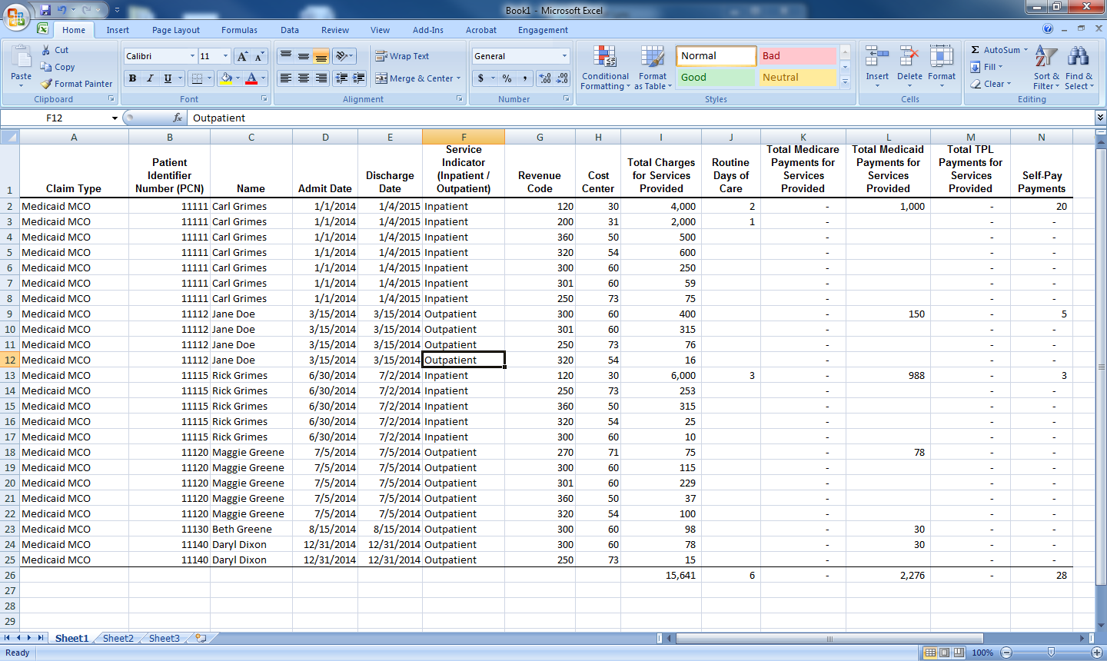
UC PAYMENT APPLICATION
DEDICATED TO GOVERNMENT HEALTH PROGRAMS

Slide 31
UC PAYMENT APPLICATION
Claims data generated by providers should be summarized by cost center, revenue code, patient days, service indicator, Medicare payments, Medicaid payments, TPL Payments and Self-Payments.
ONLY the summary should be submitted as support for the application.
  Claims data should be retained by the providers.
DEDICATED TO GOVERNMENT HEALTH PROGRAMS

Slide 32
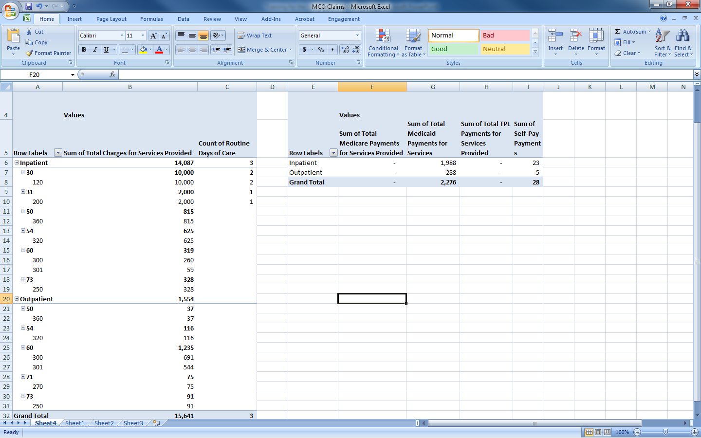
UC PAYMENT APPLICATION
2,276 Medicaid payments reported on schedule H
3 days reported on section H – In-State MCO Primary
DEDICATED TO GOVERNMENT HEALTH PROGRAMS

Slide 33
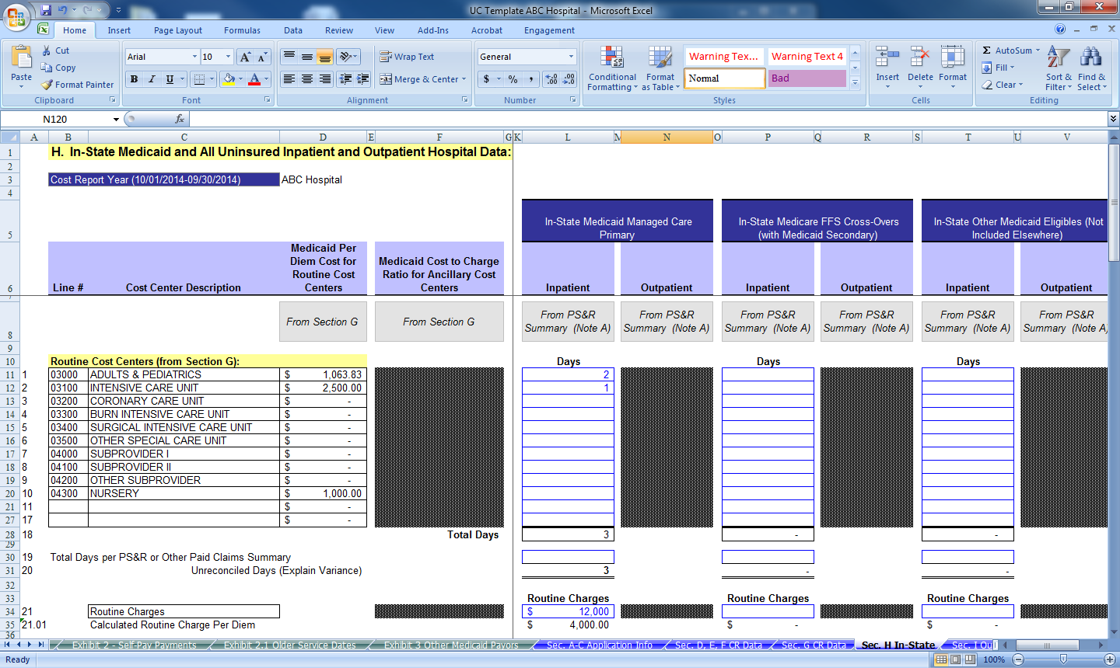
UC PAYMENT APPLICATION
From Pivot Table
DEDICATED TO GOVERNMENT HEALTH PROGRAMS

Slide 34
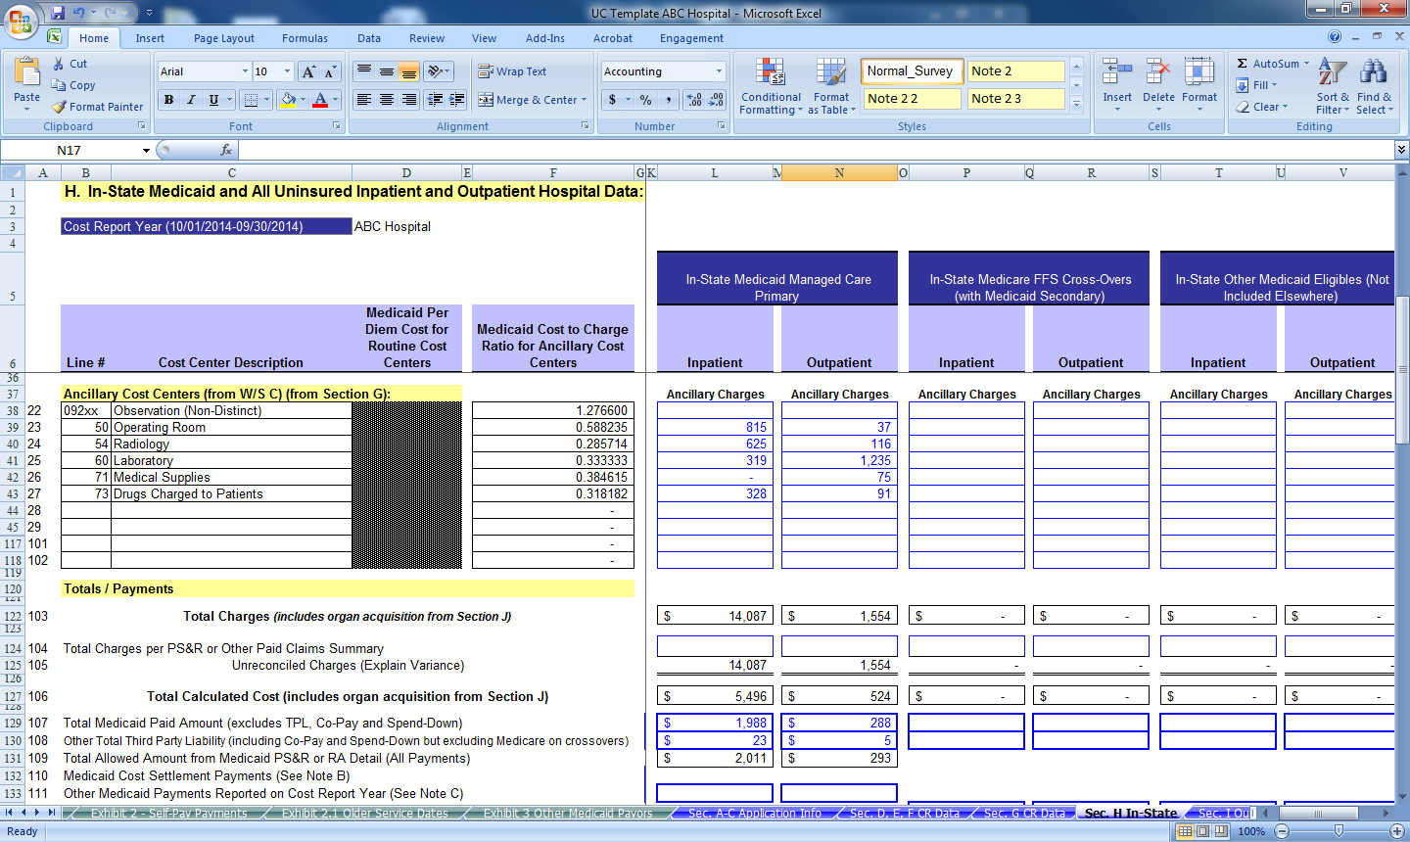
UC PAYMENT APPLICATION
From Pivot Table
DEDICATED TO GOVERNMENT HEALTH PROGRAMS

Slide 35
UC PAYMENT APPLICATION
The providers internal reports should be generated the same for all charge and payment data (MCO, FFS Cross-Over, Other Medicaid Eligible and Uninsured).
  The sole exception is Uninsured Self Payments reported on sections E and H.
  The cash collection date must fall in the calendar year, rather than the date of service (Cash-Basis Accounting).
DEDICATED TO GOVERNMENT HEALTH PROGRAMS

Slide 36
UC PAYMENT APPLICATION
The self payment report should include the following:
  Claim Type
  Account Number
  Name
  Admit/Discharge Dates
  Date of Cash Collection
  Amount of Collection
  Indicate if 1011 Payment
  Service Indicator
  Total Hospital Charges
  Total Physician Charges
  Total Other Non-Hospital Charges
  Insurance Status
  Claim Status (Exhausted or Non-Covered)
DEDICATED TO GOVERNMENT HEALTH PROGRAMS

Slide 37
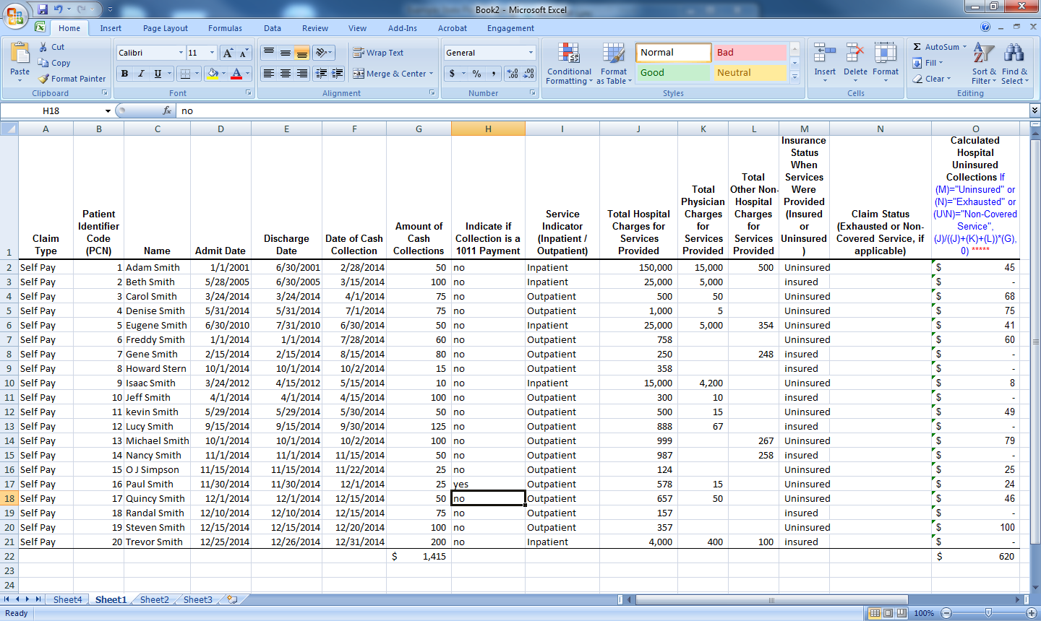
UC PAYMENT APPLICATION
DEDICATED TO GOVERNMENT HEALTH PROGRAMS

Slide 38
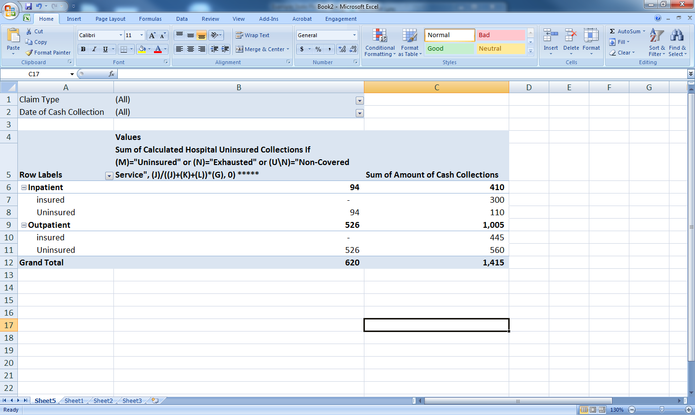
UC PAYMENT APPLICATION
DEDICATED TO GOVERNMENT HEALTH PROGRAMS

Slide 39
UC PAYMENT APPLICATION
The “Payment Adjustments” tab is used to report estimates needed to properly calculate the application year UCC.
  These estimates can be increases or decreases to reconciliation year (2014) costs and/or payments to better reflect the reimbursement climate of the application year (2016)
    Increases/decreases to utilization
    Increases/decreases to payment rates
    Changes in bed size for hospital
DEDICATED TO GOVERNMENT HEALTH PROGRAMS

Slide 40
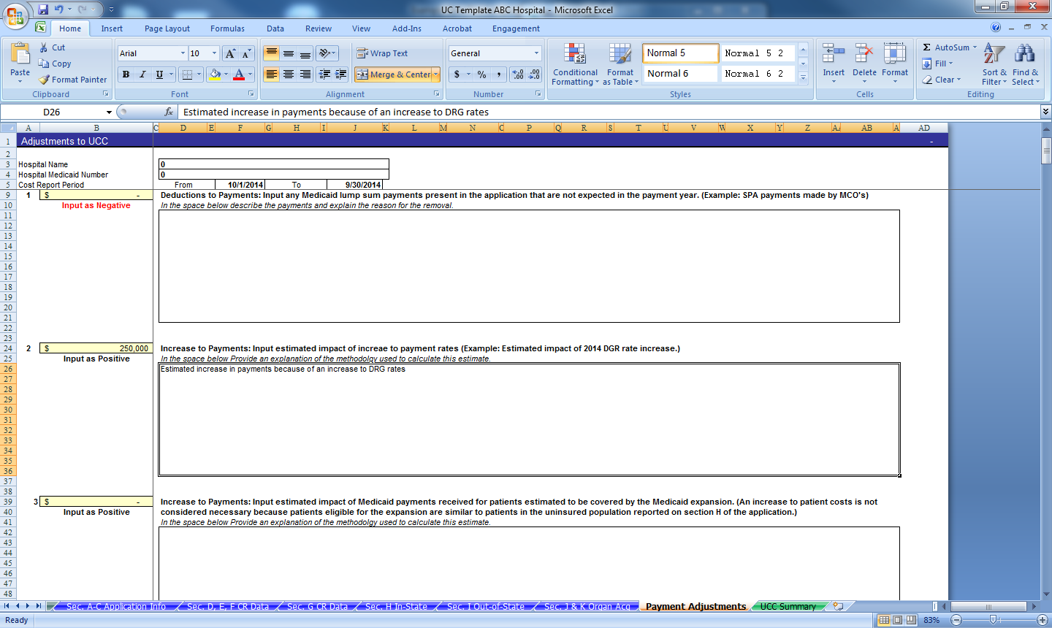
UC PAYMENT APPLICATION
Input dollar amount of estimate, as well
as an explanation of the need for the
estimate.
DEDICATED TO GOVERNMENT HEALTH PROGRAMS

Slide 41
UC PAYMENT APPLICATION
The “UCC Summary” tab shows the uncompensated care costs for In-State Medicaid buckets and the uninsured individually.
The Out-of-State calculated UCC is combined for all Medicaid payer types (FFS, MCO, Cross-over and Other Eligible).
DEDICATED TO GOVERNMENT HEALTH PROGRAMS

Slide 42
UC PAYMENT APPLICATION
Costs for inpatient and outpatient are reported in Excel column F.
Payments are reported in Excel columns H through X.
  All amounts flow from other sections of UC Application. (In-State Section H, Out-of-State Section I.)
DEDICATED TO GOVERNMENT HEALTH PROGRAMS

Slide 43
UC PAYMENT APPLICATION
Excel column AB shows the uncompensated care costs for each payer type.
  If the amount in column AB is positive, costs exceed payments, and the provider is eligible for a UC payment.
  If the amount in column AB is negative, costs are less than payments, and the provider is not eligible for a UC payment.
DEDICATED TO GOVERNMENT HEALTH PROGRAMS
Notes:
each payer type has it's UCC calculated. The hospital's UCC is calculated in the aggregate to determine the final UCC used to calculate payments.

Slide 44
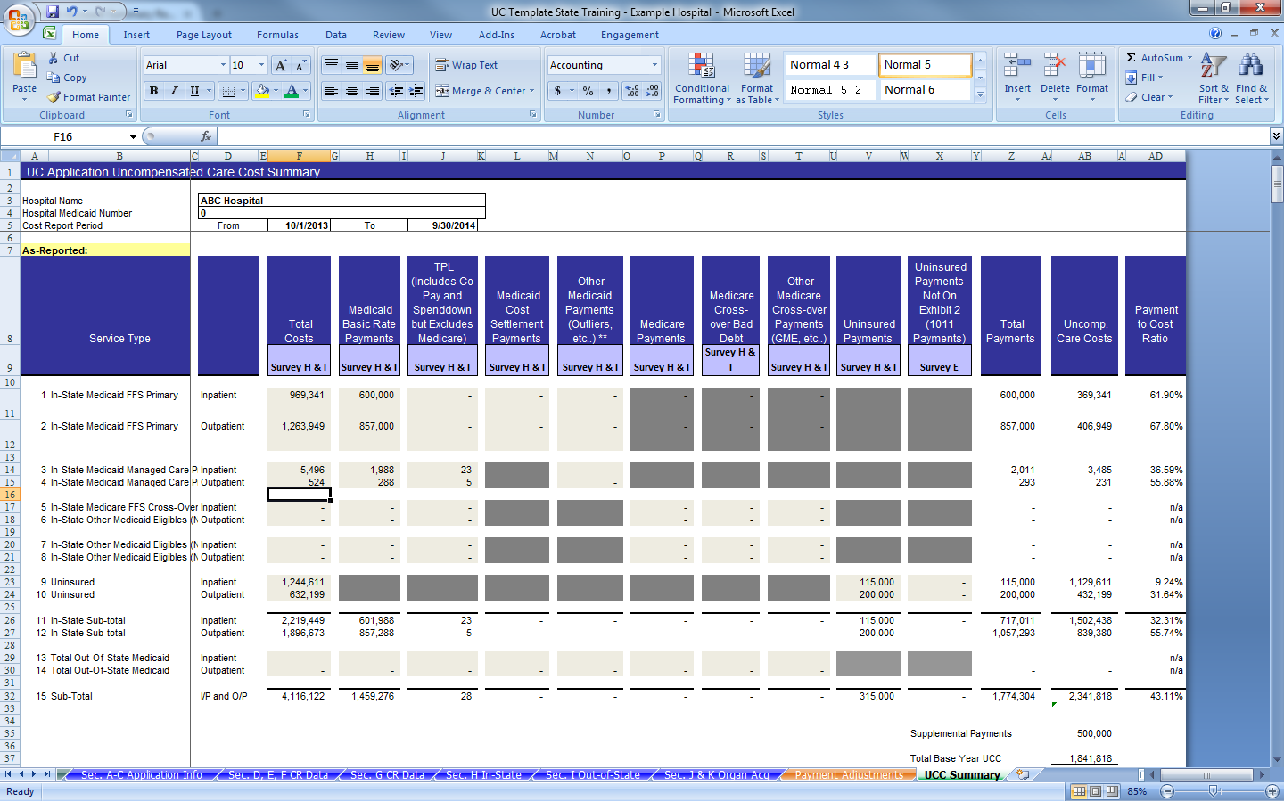
UC PAYMENT APPLICATION
Uncompensated care costs by
payer type.
DEDICATED TO GOVERNMENT HEALTH PROGRAMS

Slide 45
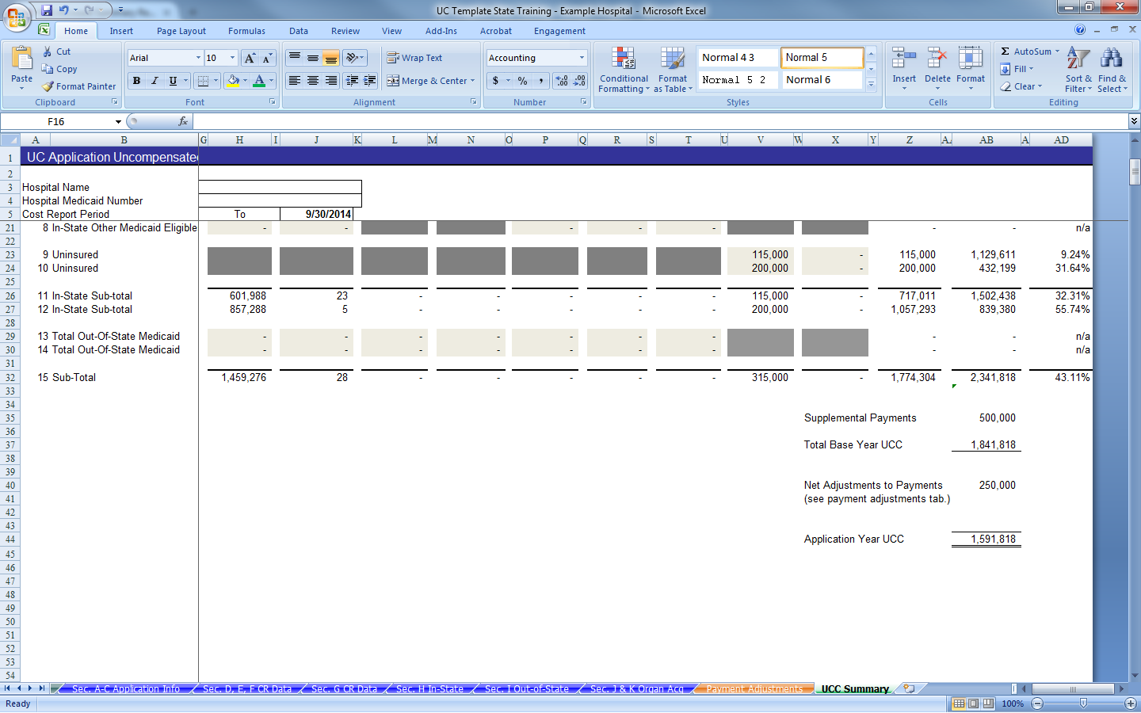
UC PAYMENT APPLICATION
DEDICATED TO GOVERNMENT HEALTH PROGRAMS

Slide 46
QUESTIONS
DEDICATED TO GOVERNMENT HEALTH PROGRAMS

Slide 47
UNCOMPENSATED CARE
INTERIM PAYMENTS
DEDICATED TO GOVERNMENT HEALTH PROGRAMS

Slide 48
UC INTERIM PAYMENTS
Payments are made to providers based on the facility UCC divided by the total UCC for the hospital group.
  Example: Hospital X has calculated Uncompensated Care Costs (UCC) of $5,000,000. Hospital X belongs to the smallest hospital group (hospitals with 30 beds or less) which has a total UCC of $50,000,000. Hospital X would be eligible for 10% of the pool allocation (5 million/50 million).
DEDICATED TO GOVERNMENT HEALTH PROGRAMS

Slide 49
UC INTERIM PAYMENTS
Providers can only receive a payment less than or equal to their calculated UCC.
  In the event that a group has a combined UCC less than the total funds allocated to the group, the excess funds are re-allocated to the next largest group.
  Example: the smallest hospital group (less than 30 beds) has a combined UCC of $35,000,000 while the total allocation to the group is $41,333,594. The remaining funds of $6,333,594 would be allocated to the small hospital group (31 – 100 beds).
DEDICATED TO GOVERNMENT HEALTH PROGRAMS

Slide 50
UC INTERIM PAYMENTS
Timeline for completion of application and processing of payments
  All UC applications must be submitted to HSD by December 31.
  HSD and/or M&S will utilized the applications to reconcile prior interim payments paid (2016 application used to reconcile 2014 payments).
    Once the reconciliations are complete, no resubmissions of applications will be permitted.
  Payments will be made within 60 days of each quarter end.
DEDICATED TO GOVERNMENT HEALTH PROGRAMS

Slide 51
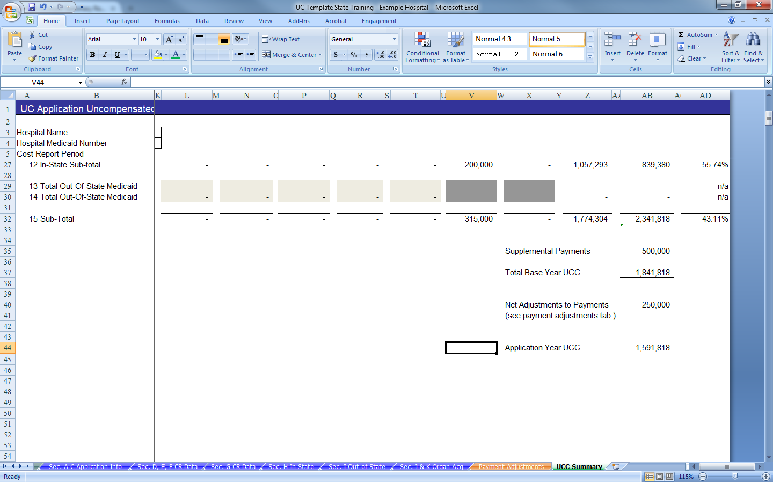
UC INTERIM PAYMENTS
  * note
Used to calculate Interim Payments
DEDICATED TO GOVERNMENT HEALTH PROGRAMS
Notes:
Generally Cell AB44 will be used to calculate interim payments. An exception could arise if the Provider included payments they received in 2014 that they know they will not receive in 2016 (DSH, GME, IME).

Slide 52
QUESTIONS
DEDICATED TO GOVERNMENT HEALTH PROGRAMS

Slide 53
UNCOMPENSATED CARE
RECONCILIATIONS
DEDICATED TO GOVERNMENT HEALTH PROGRAMS

Slide 54
RECONCILIATION
Reconciliations will be performed annually utilizing the UC Application submitted December 31
  The application for the 2016 UC payments will be submitted by December 31, 2015 with claims data from calendar year 2014
  The UCC calculated on the 2016 application (using 2014 data) will be compared to UC interim payments made in Calendar year 2014 (DY 1)
DEDICATED TO GOVERNMENT HEALTH PROGRAMS

Slide 55
RECONCILIATION
The UCC used will EXCLUDE any estimates made on the application
  These estimates are to account for known variations in 2016 that were not accounted for in the 2014 data
DEDICATED TO GOVERNMENT HEALTH PROGRAMS

Slide 56
RECONCILIATION
Used for Reconciliation
DEDICATED TO GOVERNMENT HEALTH PROGRAMS

Slide 57
RECONCILIATION
Example: Hospital ABC has a UCC from claims of $2,341,818, received supplemental payments during calendar year 2014 of $500,000 and an estimate to increased Medicaid payments due to a scheduled increase in DRG rates of 250,000 (included on estimates tab.)
DEDICATED TO GOVERNMENT HEALTH PROGRAMS

Slide 58
RECONCILIATION
The UCC that would be used to reconcile against 2014 UC payments would be 1,841,818
  Calculated: 2,341,818 (UCC from claims) – 500,000 (Supplemental Payments)
  The estimate is not included because the increase applies to 2016.
DEDICATED TO GOVERNMENT HEALTH PROGRAMS

Slide 59
RECONCILIATION
If the Providers 2014 UC interim payments are greater than the UCC calculated on the 2016 application*, the net amount will be recouped by HSD.
If the Providers 2014 UC interim payments are less than the UCC calculated on the 2016 application*, the provider would be eligible to receive additional funds up to the difference of UCC less: interim payments.
*Excluding any estimates.
DEDICATED TO GOVERNMENT HEALTH PROGRAMS

Slide 60
QUESTIONS
DEDICATED TO GOVERNMENT HEALTH PROGRAMS

Slide 61
RECOUPMENTS & REDISTRIBUTIONS
HSD will inform Providers of any recoupments and redistributions of UC funds upon completion of the annual reconciliations.
DEDICATED TO GOVERNMENT HEALTH PROGRAMS

Slide 62
RECOUPMENTS
The provider will have the option to choose ONE of the following methods for returning the funds.
  1. Make a lump sum payment to HSD using cash on hand (check)
  2. Have HSD withhold new UC payments until the balance of the overpayment is depleted.
DEDICATED TO GOVERNMENT HEALTH PROGRAMS

Slide 63
REDISTRIBUTIONS
Redistributions of Recouped funds will occur as follows:
Begin by redistributing the recouped funds to the Smallest Hospital Group. (Total Payments Cannot Exceed 60% of the UC pool.)
The Small Hospital Group would receive the next set of redistributions, Limited to 30% of UC funds plus any excess from the Smallest Hospital Group (as much as 90% of total UC pool).
DEDICATED TO GOVERNMENT HEALTH PROGRAMS

Slide 64
REDISTRIBUTIONS
The Medium Hospital Group would receive the 3rd set of redistributed funds. The sole limit to recouped funds this group could receive is the combined UCC of the hospitals in the group.
The Large Hospital Group would receive any excess from the Medium Group. While the Largest Hospital Group would receive any remaining funds after all other hospitals have been made whole.
DEDICATED TO GOVERNMENT HEALTH PROGRAMS

Slide 65
QUESTIONS
DEDICATED TO GOVERNMENT HEALTH PROGRAMS

Slide 66
Myers and Stauffer Contact Information
  Chris Maben, Senior Accountant
    maben@mslc.com
  Reuben Merriman, Senior Accountant
    rmerriman@mslc.com
  Julia Hill, Senior Manager
    juliah@mslc.com
  Telephone: (505)243-3486
DEDICATED TO GOVERNMENT HEALTH PROGRAMS

